Slide 1

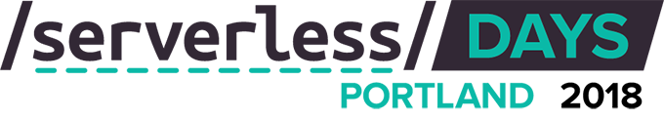

Enterprise challenges for broader serverless adoption
Serverless & Enterprise:
A love story
Eduardo Laureano
Principal PM Lead
Azure Functions
@eduardolaureano

Slide 2

About Me…
Product Lead for Azure Functions
PaaS / FaaS / Serverless for last 5 years
Passions: coding for everyone, customer & product development, Diversity & Inclusion
Wannabe triathlete during “free time” ☺
@eduardolaureano

Slide 3
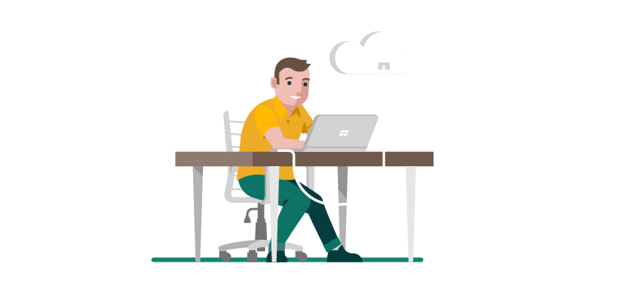
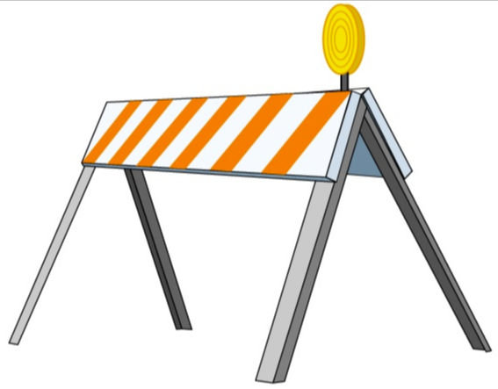






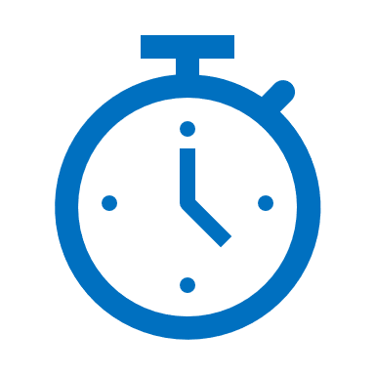
Your Typical Love Story Plot
Build apps faster
Security
Development focused
Debuggability / Monitoring
Fully-managed scale
Infrastructure Options
Long Running Stateful Apps

Slide 4
Debuggability / Monitoring

Slide 5
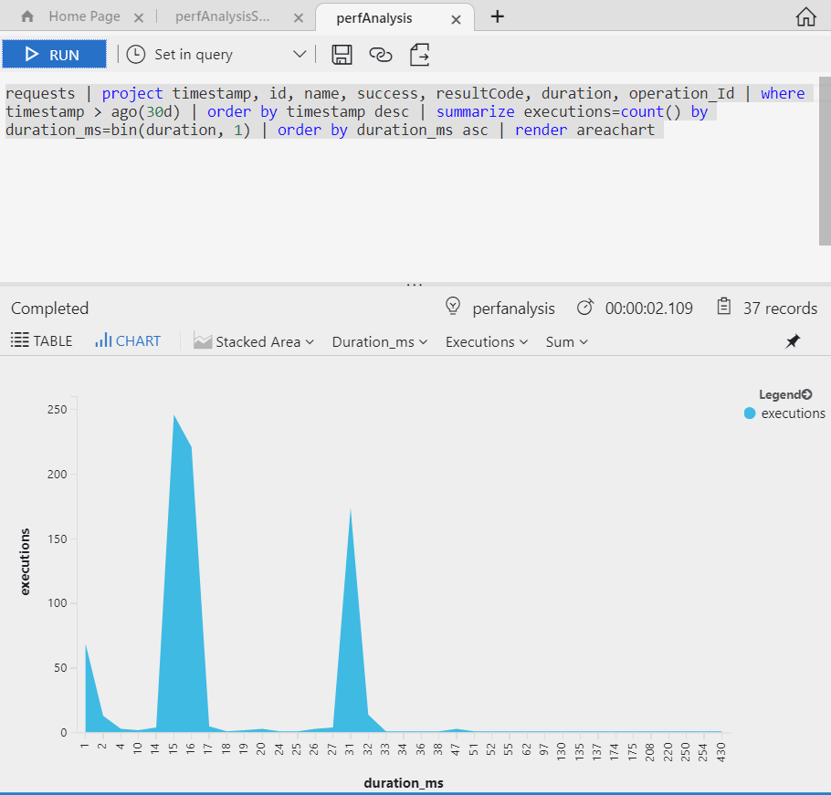
Serverless Monitoring / Debuggability
Rich Logging visualization / summarization
Local and Remote Debugging
Guided Diagnostics for common issues
Distributed Tracing ^{(NEW!)}

Slide 6
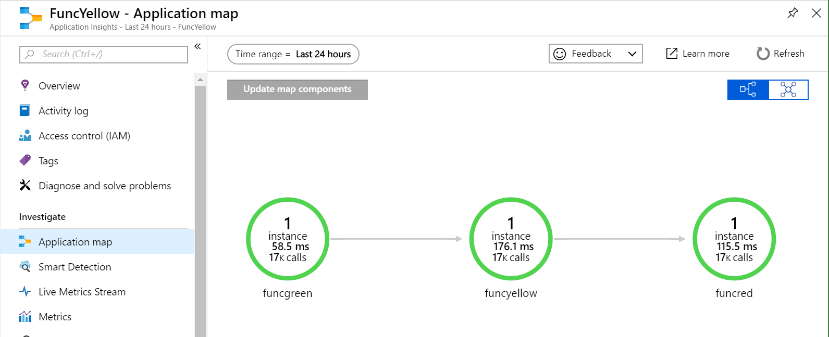
Simple App Map + Distributed Trace

Slide 7
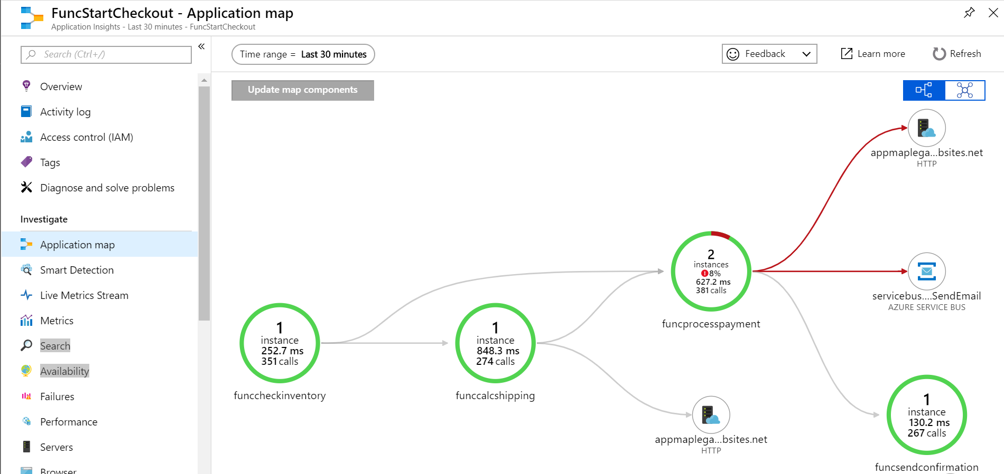

Slide 8
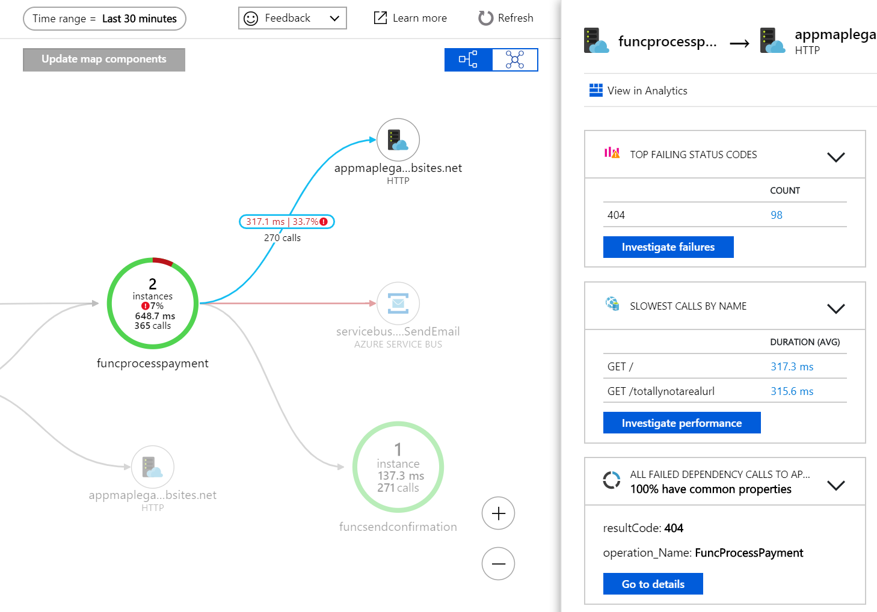
Failing Dependency Call

Slide 9
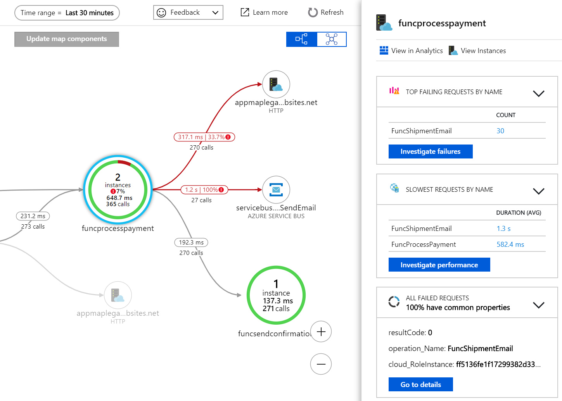

Slide 10
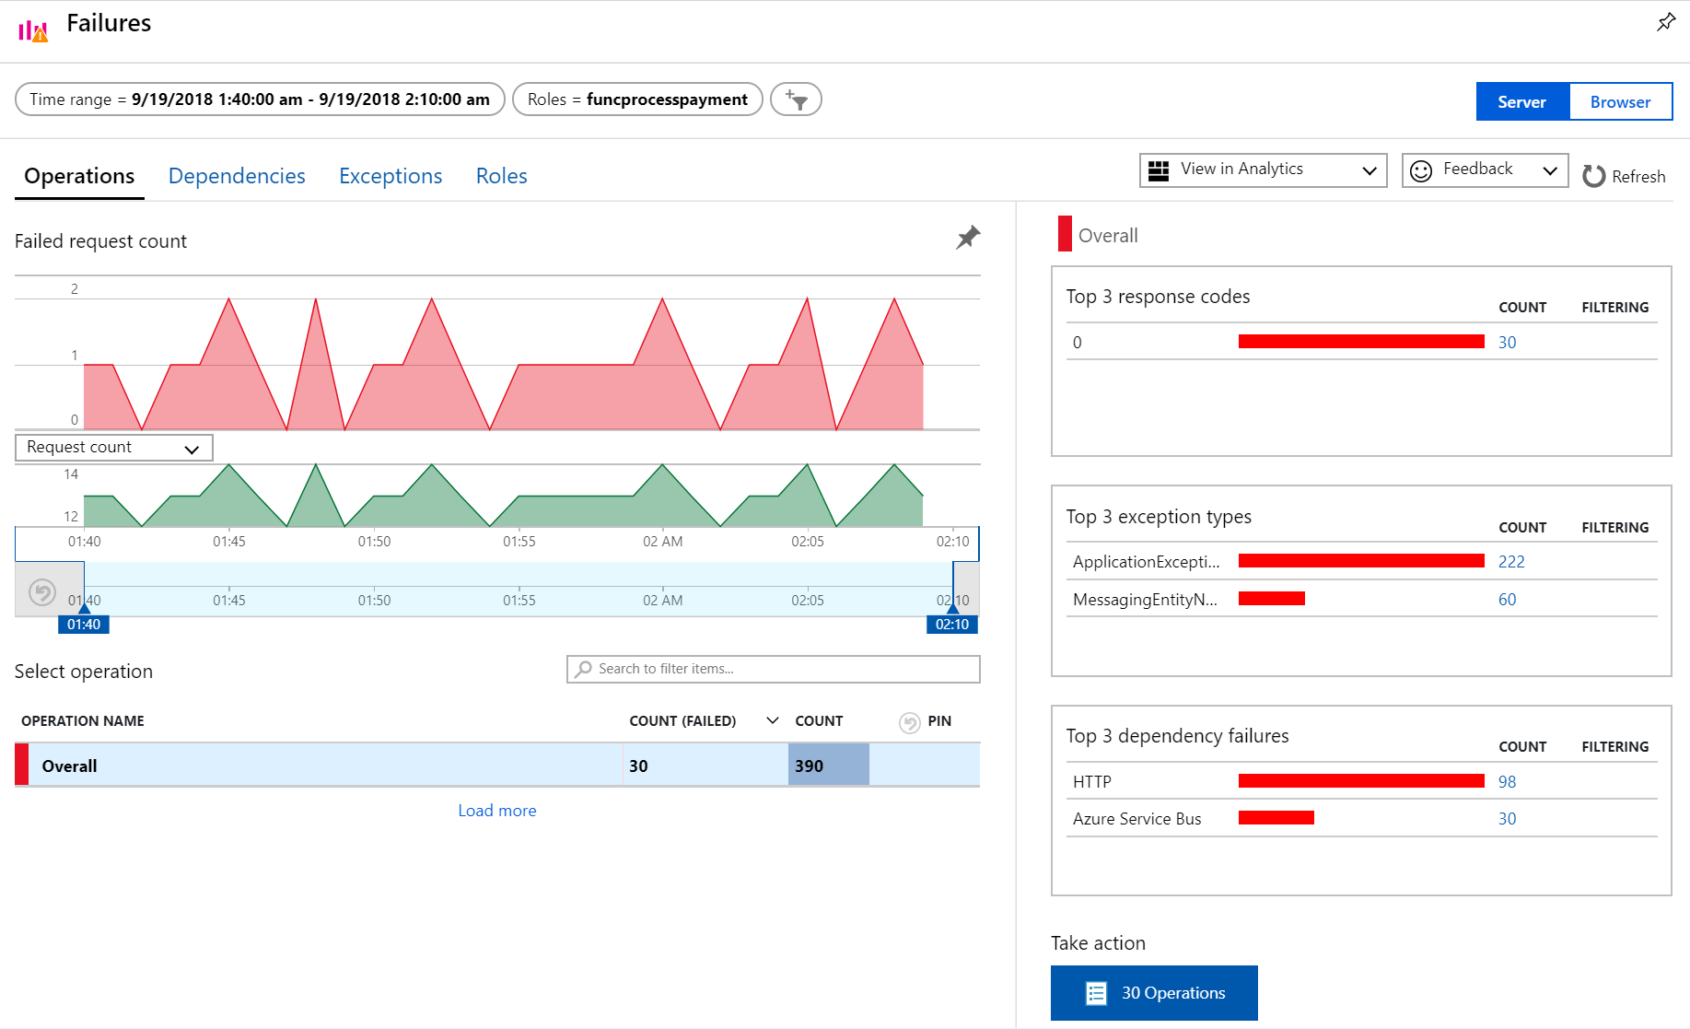

Slide 11
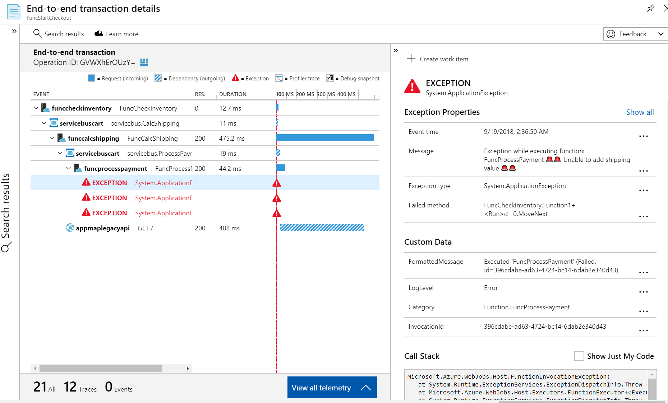

Slide 12
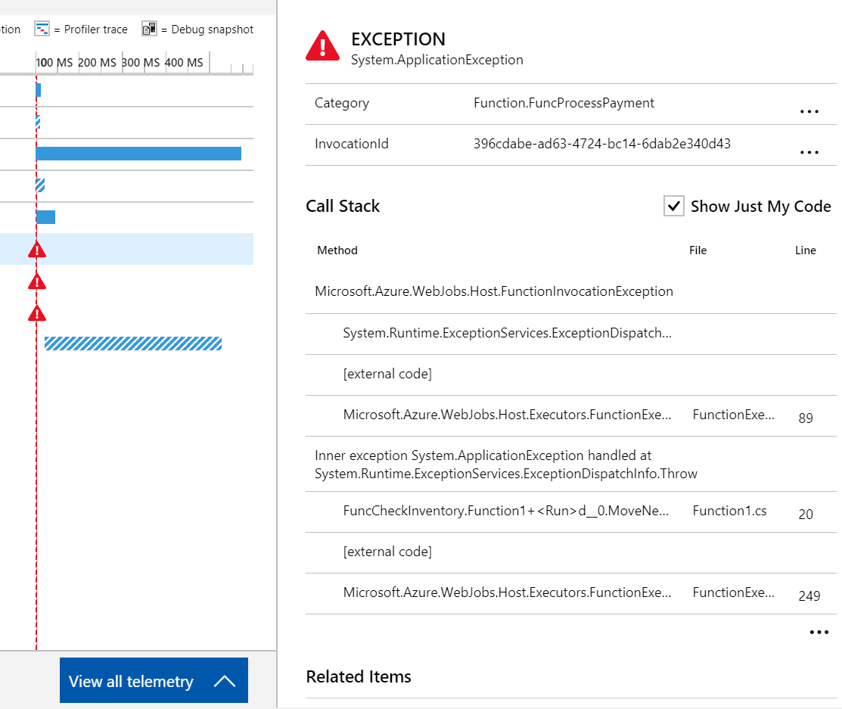

Slide 13
Long Running Stateful Apps

Slide 14
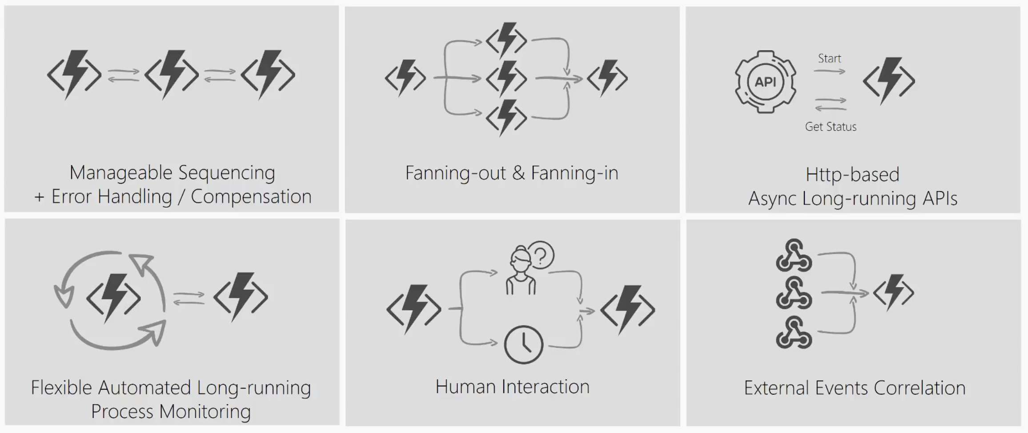
What’s still hard?
Notes:
Imagine a scenario where I have to take the output of a Function and use it as the input to call another Function. I’ll have to coordinate the chaining manually.
If I have to have a function that takes some sort of event and then parallelizes it into multiple Functions, I can still do that but how will I know when all Functions have finished executing so I can aggregate the results and move on.
What if I had to listen on multiple events and aggregate their outcome to determine which specific job or function to run in my application.
What if I wanted to do some kind of extended monitoring on an endpoint? For example, if I were to monitor the temperature of a remote machine and take action x if the temperature were lower than a certain threshold, else do y or run job y.
What if I have an API or endpoint that was running for a long time? I know Functions are short-lived but sometimes you guys put some serious load on them. Could there be a mechanism to provide status of the execution back to the client so they’re not left hanging?
And lastly, what if I wanted to get some sort of human interaction in there? For example, if I am to do some sort of 2FA in the middle of my function execution but also don’t want to wait forever because sometimes people take forever to reply especially when the texts are automated.
Today, I’m going to be talking about some of these problems – how you can approach them in regular FaaS? And how they can be simplified with the technology of Durable Functions.

Slide 15
Durable Functions
Write long-running orchestrations as a single function while maintaining local state.
Simplify complex transactions and coordination (chaining, etc.) Easily call a Function from another Function, synchronously or asynchronously.
All of the above using code-only. No JSON schemas. No graphical designer.
Supports C# (GA) and JavaScript (Preview)
Notes:
Durable Functions is an advanced feature of Azure Functions. They provide the ability to write long running orchestrations using a single function while still being able to maintain a global state.
Durable highly simplifies some of the scenarios that we saw in the previous slides by making it easy to implement scenarios such as chaining, fan out / fan in , etc.
While still being able to use your beloved code constructs. You don’t have to conform to an JSON schemas or adopt any graphical workflow designers.
So let’s take a look at what it means to use Durable Functions ….. with some real world problems or patterns ->

Slide 16
Components
Starter
Function
Orchestrator Function
Activity Function
Activity Function
Activity Function
Starts orchestrations
Coordinates activities
Performs work
OrchestrationClient
OrchestrationContextTrigger
ActivityTrigger

Slide 17
What It Looks Like
Orchestrator Function
// calls functions in sequence
public static async Task<object> Run(DurableOrchestrationContext ctx)
{
try
{
var x = await ctx.CallActivityAsync("F1");
var y = await ctx.CallActivityAsync("F2", x);
return await ctx.CallActivityAsync("F3", y);
}
catch (Exception)
{
// global error handling/compensation goes here
}
}
Activity Functions
Notes:
> So in Durable Functions, we introduce the concept of “an orchestrator" that will orchestrate or manage what happens between rest of the Functions.
> It is responsible for calling and receiving output from activity functions that you’re familiar with as regular functions. When an activity returns, it return value becomes part of the local state of the orchestrator function so you’re able to work with it as any other variable in that block of code.
> CallFunctionAsync uses queues under the covers, thus they can be scaled out to multiple VMs.
The other thing is that if I want to have exceptions in my code, say something goes wrong in a particular function, I can do that. We’re all familiar with the syntax and now we can do it in a distributed way.
Mention rewind feature to talk about in new developments

Slide 18
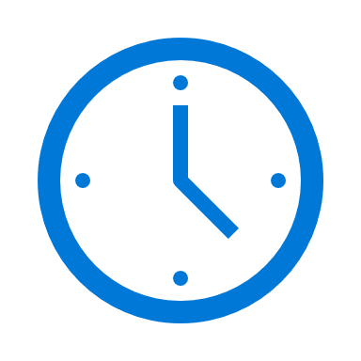

var outputs = new List<string>();
outputs.Add(await context.CallActivityAsync<string>(“Hello”, “Portland”));
return outputs;
History Table
Orchestrator Function
Orchestrator Function
Activity Function
Orchestrator Started
Activity Function
Execution Started
Task Scheduled, Hello, “Portland”
Orchestrator Completed
[“Hello Portland!”]
“Hello Portland!”
“Hello Portland!”
Task Completed, “Hello Portland!”
?
Orchestrator Started
Execution Completed, ["Hello Portland!"]
Orchestrator Completed
Execution History
Notes:
Grasping how orchestrators use execution history to replay and rebuild their local state is key to understanding how Durable Functions works, so let’s walk through the execution of a simple orchestrator function.
The light blue box at the top of the slide is the orchestrator’s code.
“SayHello” our activity function, which returns “Hello” and whatever input you give it.
Our execution history is currently empty. As we start to record events, they’ll show up here. (Indicate area.)
1. A request is made to the orchestrator function.
2. The orchestrator starts and begins executing until it’s asked to await some async work. In this case, we want to call an activity function.
3. The orchestrator checks the execution history for a record of the activity function.
4. There’s no record of the activity function being called or completed, so the orchestrator schedules that work.
5. While the orchestrator waits on work to complete, it shuts down.
5. The scheduled activity function runs.
6. A record of this is added to the execution history. In this case we produced output, so that’s stored.
7. Now the orchestrator has more work to do. It restarts and executes its code **from the beginning** to build up its local state.
8. As before, the orchestrator executes until it reaches an await.
9. The orchestrator checks the execution history. This time there’s a record of the async work being done.
10. The activity function’s stored output is passed back to the orchestrator. In this case, the value is added to a list of strings.
11. The orchestrator continues executing. In a more complex orchestrator with multiple await calls, the checkpoint, schedule and replay steps would repeat for each one. This orchestrator runs to completion and returns its output.
12. And we’re done!
- How does the framework know to wake up

Slide 19
Infrastructure Options

Slide 20
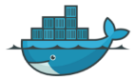

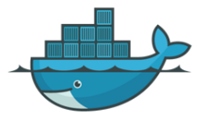
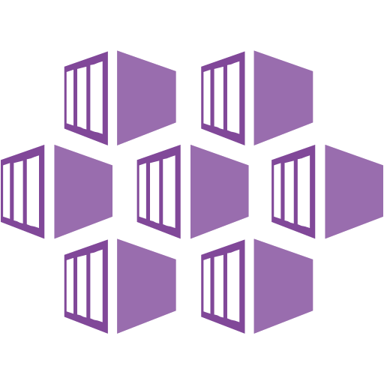





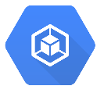








Functions Hosting Models
Serverless Functions
Linux
Functions
Kubernetes
Functions
Open Source
Hosting
IoT
Functions
On Prem
Functions
Application
Delivery
Execution
Isolation
Infrastructure
Operating System
Azure Managed
Customer Managed

Slide 21
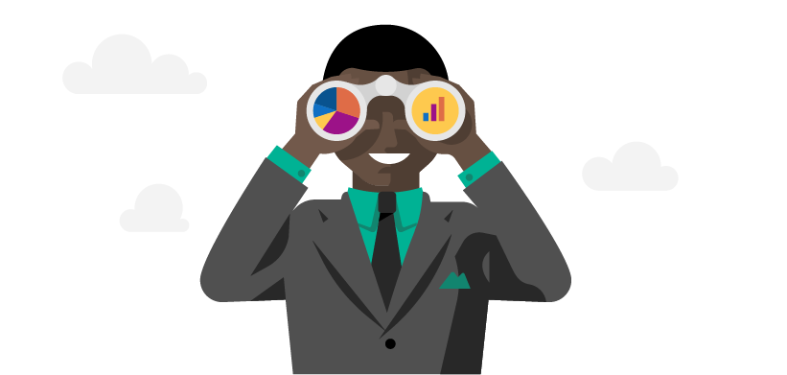



Your Typical Love Story Plot
Build apps faster
Security
More scenarios
Development focused
Debuggability / Monitoring
Better platform usage
Fully-managed scale
Infrastructure Options
Increased Efficiency
Long Running Stateful Apps

Slide 22
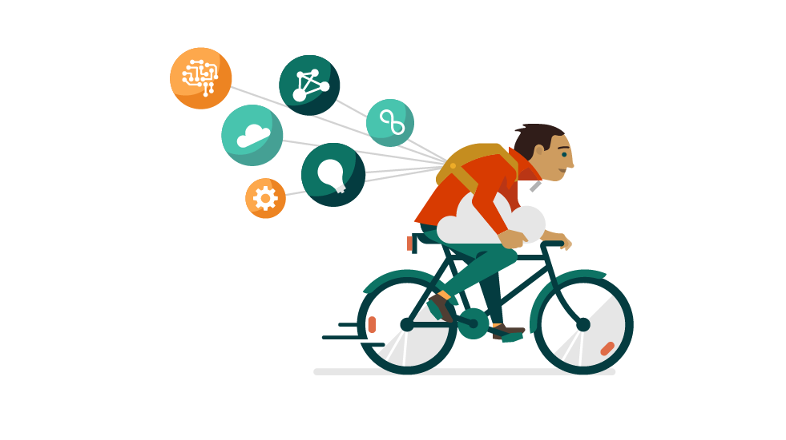
Takeaways
Enterprises requirements are hard, but not a reason to avoid FaaS / serverless
Leverage the cloud for orchestration, authentication, DevOps, monitoring, and more
Choose technologies that gives not only easiness of dev, but also power and flexibility
It’s an open source world, participate and contribute
https://aka.ms/serverlessdayspdx

Slide 23
Thank you!

